Slide 1
Abnormality Detection and Predictions on Unseen Diseases in Chest X-ray Images
Minh Hoang, Varich Boonsanong, Yuxin Wu, Ludvig Liljenberg

Slide 2
Introduction
The motivation for this study stems from the challenges faced during the COVID-19 pandemic in identifying the virus from chest X-rays due to the lack of labeled training data.
We apply Computer Vision and Deep Learning for the tasks of abnormality detection and unseen diseases prediction, in order to explore the possibility of utilizing previously trained models to detect abnormal regions and help predict new, unseen diseases in chest X-ray images.

Slide 3
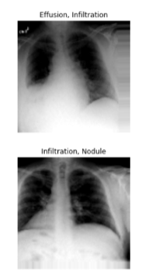
Dataset 1
NIH Chest X-ray14 dataset
dataset of frontal-view chest X-ray images.
112,120 frontal-view X-ray images of 30,805 unique patients, for a total of 14 disease labels:
Consolidation, Infiltration, Pneumothorax, Edema, Emphysema, Fibrosis, Effusion, Pneumonia, Pleural-thickening, Cardiomegaly, Nodule, Mass, Hernia and No Finding
For training and validation.

Slide 4
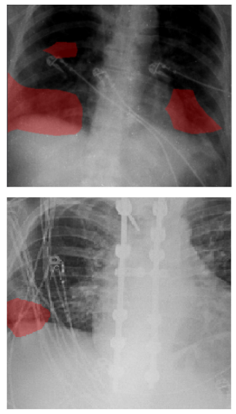
Dataset 2
COVIDx CXR-2 dataset
Dataset of frontal-view chest X-ray images.
29986 images from 16648 patients, with binary label indicating whether the patient has COVID-19 or not.
For testing our models on unseen diseases.

Slide 5
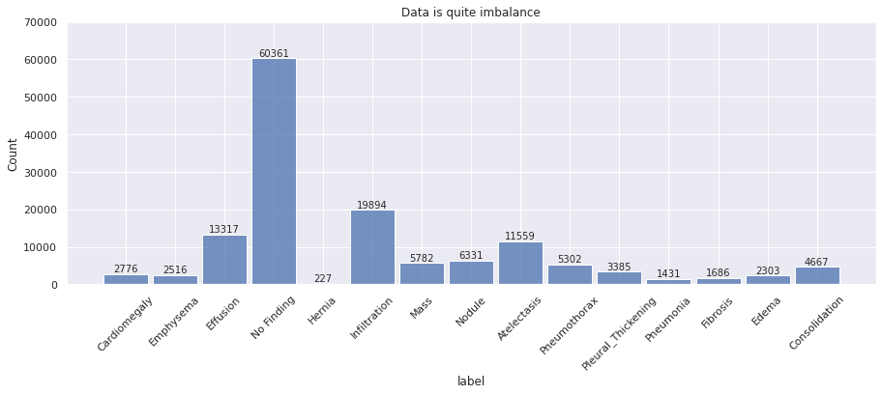
Exploratory Data Analysis
Distribution of data labels in the Chest X-ray14 dataset:

Slide 6
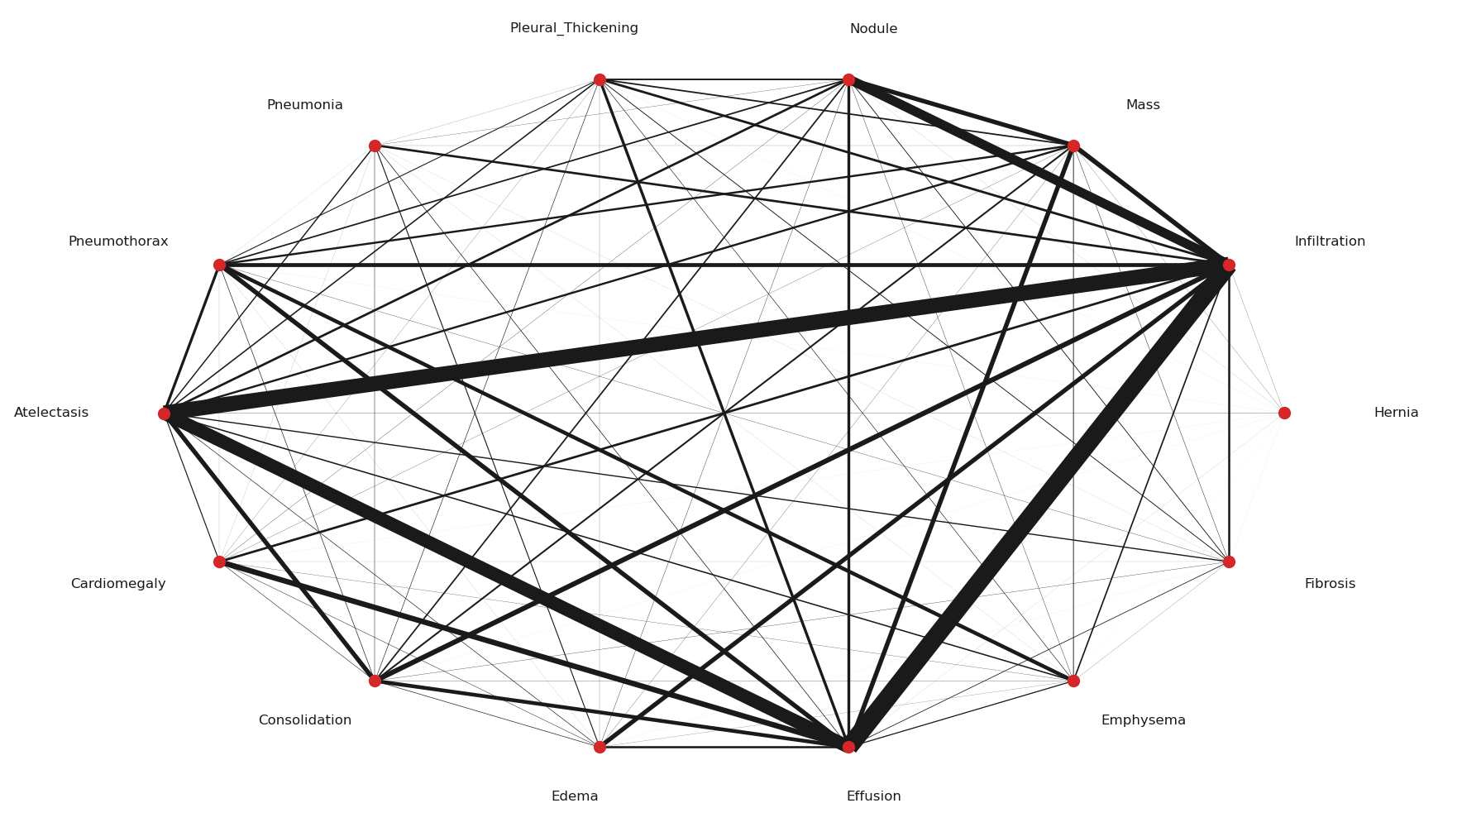
Exploratory Data Analysis
Correlations of different diseases in Chest X-ray14 (a single image could have multiple diseases):
Notes:
As we can see from the graph, there are significant amount of population that have multiple diseases at the same time. Most notably, People who have Infiltration also have Effusion.

Slide 7
Method
Task 1: Case Study of Abnormality Detection.
We train several binary classification deep learning models to detect abnormalities in the Chest X-ray14 dataset. We want to find the best Deep Learning model, so we can use it in Task 2.
Task 2: Predictions on Unseen Diseases.
Using the best model architecture from Task 1, we exclude 1 out of the 14 diseases from the Chest X-ray 14 dataset, and re-train a binary classification model. We evaluate the model using the held-out disease as a test-set, to see if the model can correctly detect abnormalities in patients with the held-out disease.
Secondly, we also use the COVIDx CXR-2 dataset as a test-set, to see if the model (which is not trained on COVID-19 data), can identify abnormalities in COVID-19 patients.

Slide 8
Models
Using a caviar strategy, we have picked 8 supervised learning models for our case study, all pretrained on ImageNet (Loss function: Binary Cross Entropy loss; Optimizer: Adam optimizer; Learning rate: 0.0002; Weight decay: 0.00002; Epochs: 10)
ResNet-50
ResNet-152
DenseNet-121
VGG19
MNasNet0.5
ResNeXt-50
InceptionV3
EfficientNetV2-S
Each model is followed by one or multiple fully connected layers, along with ReLU activation function, a dropout layer of 0.2 to prevent overfitting, and a Sigmoid layer at the end.

Slide 9
Evaluation Metrics
Precision: Precision is defined as the number of observations that are correctly classified as true positives over the number of total positives (true positives + false positives).
Recall: Recall (or sensitivity) is defined as the number of observations correctly classified as true positives over the number of true positives and false negatives.
F1-score: F1-score is the harmonic mean of precision and recall metrics ( F1-score = 2 ∙ Precision ∙ Recall / (Precision + Recall) ).
Matthew’s Correlation Coefficient (MCC): MCC is defined as the correlation between the predicted observations and their respective ground truths ( MCC = (TP ∙ TN - FP ∙ FN) / √(TP + FP)(TP + FN)(TN + FP)(TN + FN) ).
ROC-AUC: ROC-AUC is the area under the receiver operating characteristic (ROC) curve.

Slide 10
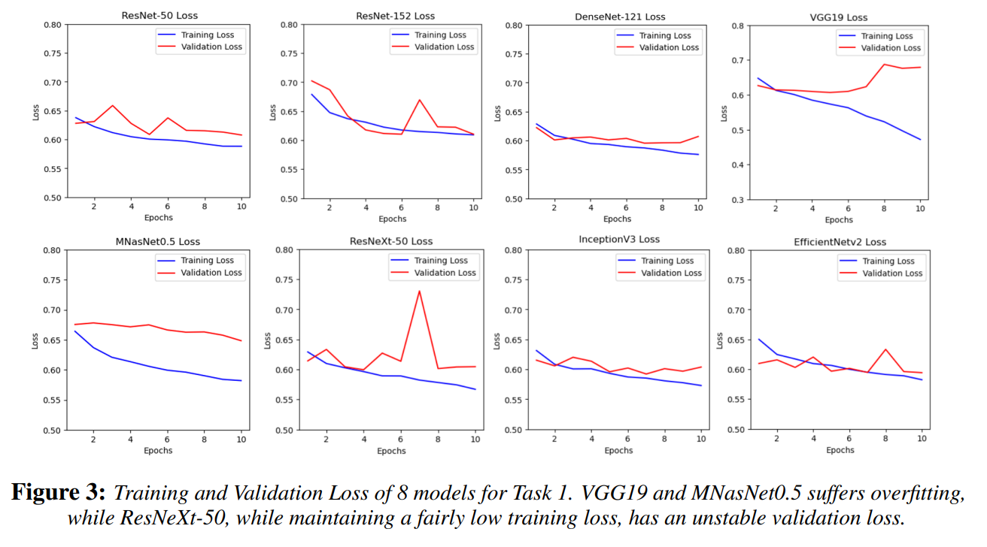
Results for Task 1

Slide 11
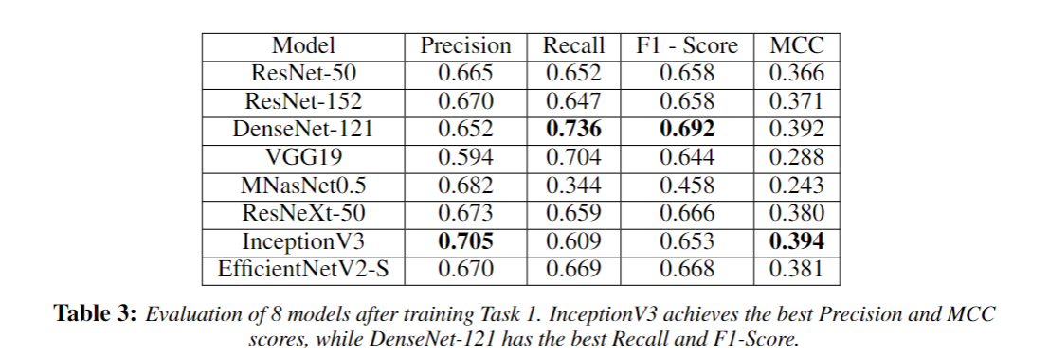
Results for Task 1
We use the above mentioned metrics to evaluate our models in Task 1. No model performs the best in all metrics.

Slide 12
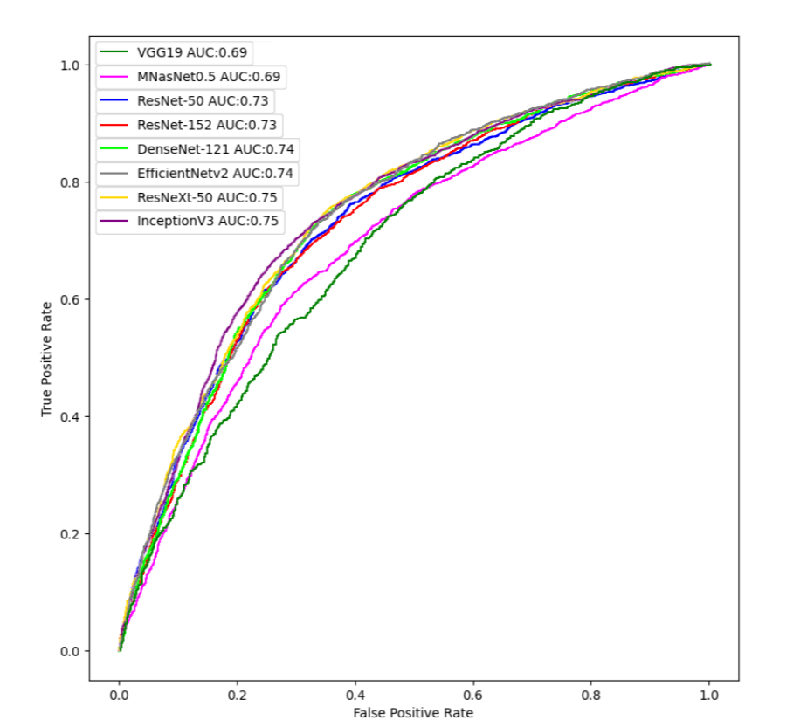
Results for Task 1
Based on the results from this, we decided to keep InceptionV3 and DenseNet-121 for Task 2.

Slide 13
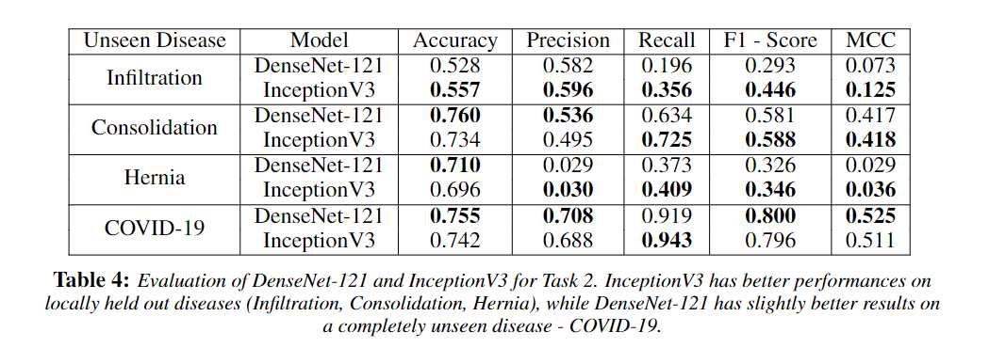
Results for Task 2

Slide 14
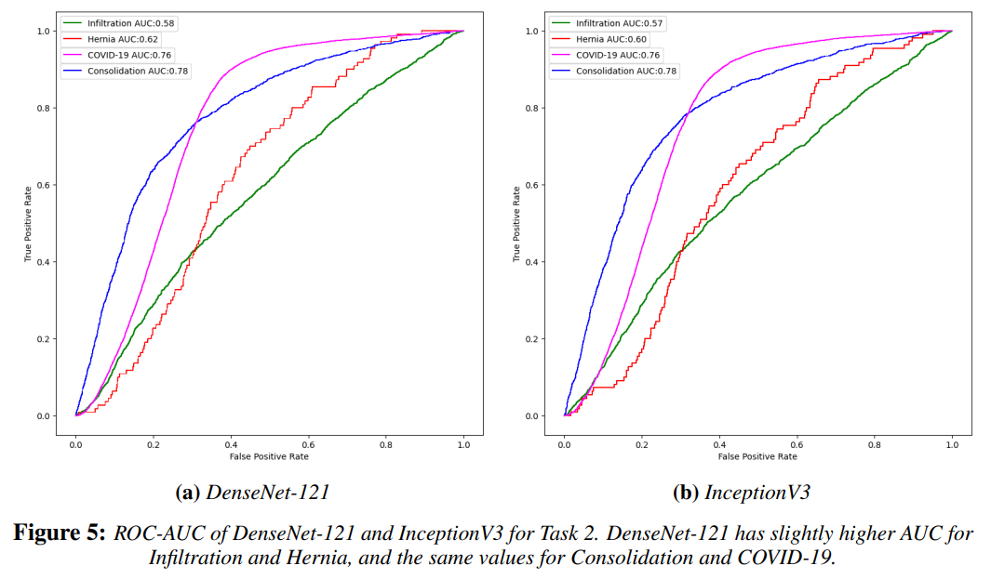
Results for Task 2

Slide 15
Discussion
In Task 1, we conduct a case study to compare 8 supervised learning models on detecting abnormalities cause by one or more diseases with high accuracy.
In Task 2, we simulate few shot learning by held out some diseases and models can still manage to correctly predicted those disease as newly emerged.
With relatively high accuracy, we are able to detect abnormalities in COVID-19 patients, without having COVID-19 data in the training data
Note that there are no single model that single handedly outperform every other models in all metrics.

Slide 16
Limitations
Still needs trained medical personnel to considered other symptoms that are not measurable by X-ray images.
For Task 2, we ideally want to test all 8 models from Task 1. However, with limited computing resources, we choose to test on only best 2 (Densenet-121, InceptionV3) using Task 1 as the benchmark.

Slide 17
Future Works
Extend our models to perform multi-label classification of multiple diseases at the same time, so that they can predict more than one unseen disease simultaneously.
Create saliency map to show the area that contribute to the diagnosis of given class.
Compare general purpose classification models (ResNet, EfficientNet) with task-specific (XNet) in “few shot” learning settings.
Notes:
So far, we only focus on binary classification tasks in our analysis. One possible extension is to apply our models to perform multi-label classification of multiple diseases at the same time, so that they can predict more than one unseen disease simultaneously.
Our models successfully detect whether or not an image has abnormal regions but have yet to correctly visualize such regions. If given more time and computational resources, we can modify our models to output those abnormal regions and calculate the probability of which disease one region belongs to, should an image has multiple disease labels.
Our model choice focuses mainly on supervised learning models, namely well-known pre-trained CNN models. In the future, we can explore different types of models, such as unsupervised learning models like Autoencoders (AEs) or Transformer-based models.
It is possible that our models may have potential biases. Therefore, should we continue with our project, we can explore the bias in our classification models and the correlation of such bias with a specific disease. It might be possible that the current models will be biased toward a specific disease if the image happens to have a certain type of artifact that types of machines can cause.
Our work focuses on repurposing general classification models (ResNet, EfficientNetV2), which should be able to generalize well. However, there are several X-ray-specific models such as XNet \cite{xnet}, which have shown to be superior in classification tasks but may not generalize in few-shot or zero-shot learning settings \cite{lu2022image}. We can investigate and compare our general classification models with those task-specific models in few-shot learning settings.

Slide 18
Conclusion
In this paper, we have shown with empirical results that it is possible to use transfer learning of deep learning models to help classify newly emerged pandemic from Chest X-ray without seeing the data first.
For instance, we have shown with transfer learning model from InceptionV3 that the resulting model can distinguish between newly emerged disease and old diseases with accuracy up to 70%, Precision of 71%, Recall of 60%, F1-score of 0.65, and MCC of 0.39.
We hope the success of this model will help lower the barrier of applying deep learning to assist diagnosis at the start of pandemic and consequently facilitate medical staff to help patient more efficiently.

